Slide 1
Human Computer Interaction
Introduction and Overview

Slide 2
Why Systems Fail?
Inadequate requirements 13%
Lack of user participation 12%
Inadequate resources 11%
Unrealistic expectations 10%
Lack of support at senior level 9%
Changing specification 8%
Lack of planning 8%
Notes:
What is the conclusion that can be derived from the statistics?

Slide 3
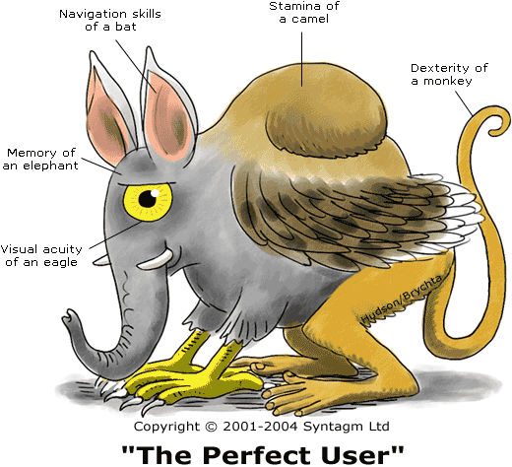
The Perfect User (every designer ‘s wish)

Slide 4
Common Issues in User Interface Design
Software developers are forced to “do it all”
Often based on intuition and experience than on theory-based models
Tendency to let the art of interface design beats its usability
Inconsistent features that do not fit into a good user interface design criteria
Notes:
Now we are going to look at one common issue in user interface design.
An ideal setup of software engineering would require user interface experts to handle the interface development,
however in real life, not all software development projects can afford specialist for each and every development task,
hence it is very likely that the programmer will be pushed to do both codings and user interface designing.
Without the talents and proper training, the interface design will be based on intuition rather than the theory.
Which will result in the tendency to let the artistic features of user interface beats its usability.
This is usually where the inconsistent features that do not fit into a good user interface design criteria come from.

Slide 5
Why Study HCI?
Business view :
  to employ people more productively and effectively
    - people costs now far outweigh hardware and software costs
  people now expect “easy to use” systems
    - generally they are not tolerant of poorly designed systems
    - if a product is hard to use, they will seek other products

Slide 6
Why Study HCI?
Human Factors view :
  Humans have limitations.
  Errors are costly in terms of
  - loss of time & money
  - loss of lives in critical systems
  - loss of morale

Slide 7
What is HCI
Short for human-computer Interaction.
A discipline concerned with the study, design, construction and implementation of human-centric interactive computer systems.
The study of how people interact with computers and to what extent computers are or are not developed for successful interaction with human beings.
Human-computer interaction is a discipline concerned with the design, evaluation and implementation of interactive computing systems for human use and with the study of major phenomena surrounding them.
Notes:
Short for human-computer Interaction, a discipline concerned with the study, design, construction and implementation of human-centric interactive computer systems.

Slide 8
The Goal of HCI
The goals of HCI are to develop or improve the safety, utility and effectiveness of systems that include computers, often through improving usability.

Slide 9
The Goal of HCI
Usability
People are trying to accomplish their tasks in life. (system independent)
Introduce a system, User Interface should maximize their ability.
task
person
system

Slide 10
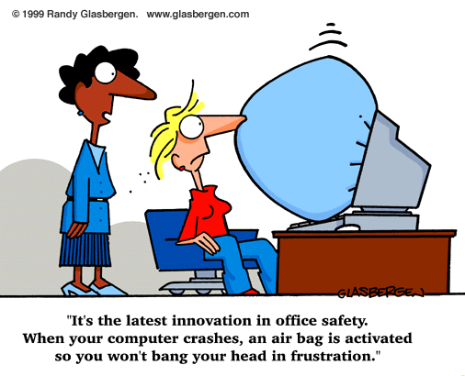
What is usability?
Usability can simply be thought of as the practical
implementation of good HCI, but, more formally :
  Usability means easy to learn, effective to use and providing an enjoyable experience

Slide 11
Usability is hard
People (users) are all different
People are unpredictable
Design skill isn’t enough
Evaluation with users is required
Designer’s pride
New ways to think, break out of the box
Programmers stink (smell) at Usability

Slide 12
Usability is hard
Programmers stink at Usability
  don’t think like ‘normal’ people
  know the software internals, technology first
  enjoy systems more than people
  arrogant (my software!)

Slide 13
How does IT work?
Usability Engineering
Reqs Analysis
Evaluate
Design
Develop

Slide 14
How does it work?
Usability Engineering
Reqs Analysis
Evaluate
Design
Develop
many iterations

Slide 15
What will I learn?
Task analysis
Ethnography
Reqs Analysis
Usability studies
Controlled experiments
Evaluate
Design
Activity design
Information design
Interaction design
Develop
GUI programming
Widgets, graphics, animation
C#

Slide 16
Why HCI is important ?
The study of our interface with information.
It is not just ‘how big should I make buttons’ or ‘how to layout menu choices’
It can affect
  Effectiveness
  Productivity
  Morale
  Safety

Slide 17
Why is HCI important?
In order to achieve efficient, effective and safe products/systems:
  Productivity (introducing technology that does not support the work may cause reduced productivity)
  Safety (crashed air planes and nuclear power plant disasters have led to an understanding why HCI is important!)
Computers should be designed for the needs and capabilities of the people for whom they are intended!
Notes:
Productivity and safety are two clear reasons why good HCI design is crucial.
In the early 80’s the Three Mile Island nuclear power plant disaster nearly resulted in a meltdown of the nuclear reactor.
The reason was a combination of operator error and bad interface design.
The incident could have been prevented if the control panels had been designed to provide the operators with the necessary information to enable them to perform their tasks efficiently and correctly.
Now we have a better knowledge in HCI, but it doesn’t make it less important in today’s safety critical systems.

Slide 18
Important!!!
Users should be involved throughout the development of the project (How?)
Specific usability and user experience goals need to be identified, clearly documented and agreed at the beginning of the project

Slide 19
Understanding interaction
User centric design is the formula for usability
The key to User-centered Design is to understand Interaction
We need to understand :
  What Interaction is
  What are the elements involved

Slide 20
Interaction Model
The most influential model of interaction is Donald Norman’s (http://www.jnd.org/) :
Execution-Evaluation cycle
Norman divides interaction into :
  Execution
    User activities aimed at making the system do something
  Evaluation
    Evaluating whether the system did actually do what the user wanted

Slide 21
Understanding Interaction
Execution
  If User cannot make system do what they want
    e.g. cannot understand how to do it, unclear icons, unclear indication etc.
  Will result in the Gulf of Execution
    i.e. difference between the user’s formulation of the action and the actions allowed by the system

Slide 22
Understanding interaction
Evaluation
  If user cannot see what happened to system
    e.g. if system has done what they want but no feedback is given to the users etc.
  Will result in the Gulf of Evaluation
    i.e. difference between the representation of the system state/result and the expectations of the user
Good Design aims to reduce these gulfs

